Slide 1
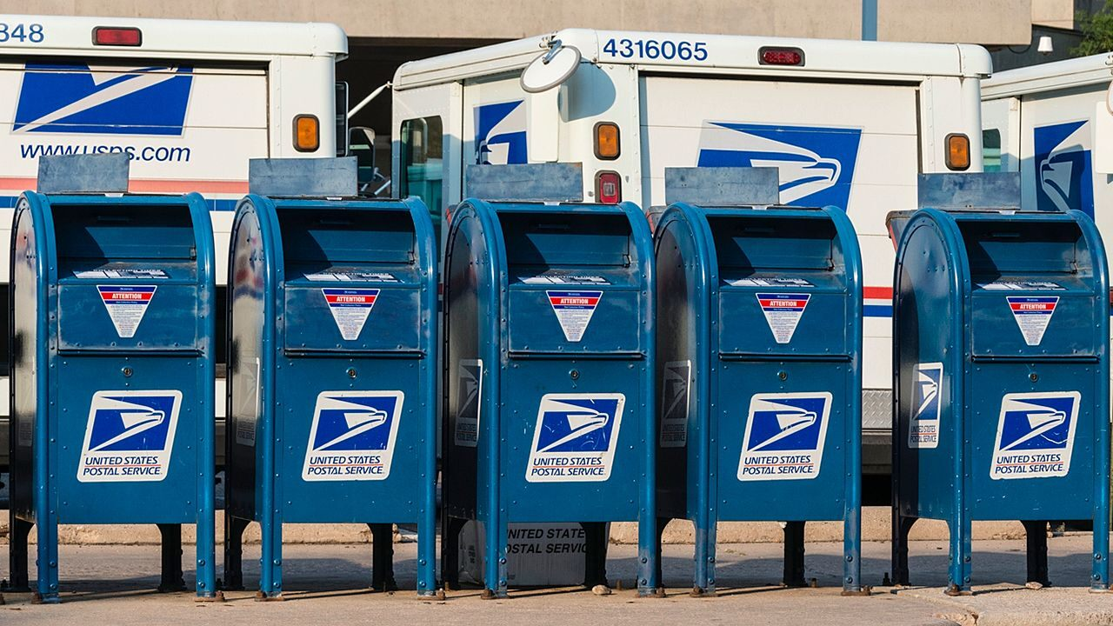
Mail Entry & Payment Technology
United States Postal Service
Downloading the IMb Font for Using Mail Merge With the IMsb Tool
July 2021
Notes:
The following slides will walk IMsb Tool users who are attempting to perform a Mail Merge through the process of downloading the IMb Font, which is required to properly print an IMb for their addresses when using Mail Merge.

Slide 2
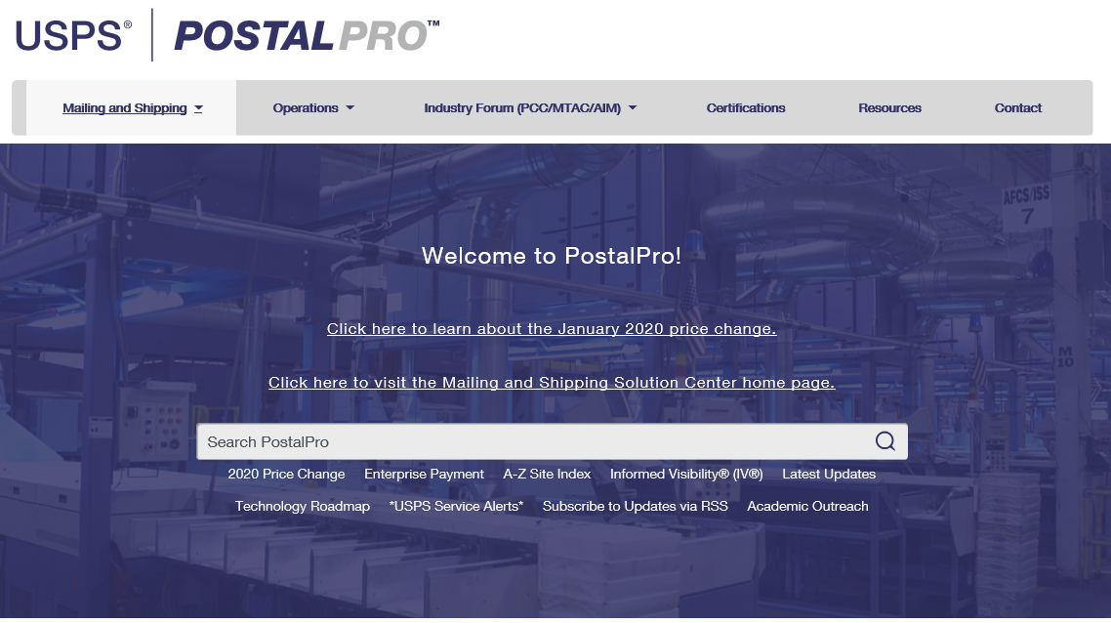
Mail Entry & Payment Technology
USPS IMb Font Download
In order to be able to use Mail Merge with the IMsb Tool, the USPS IMb Font must be downloaded to your computer.
The downloadable fonts are found at: https://postalpro.usps.com/onecodesolution
Notes:
The fonts can be difficult to locate using the Search feature or the A-Z Index in PostalPro.
Use the link provided.

Slide 3
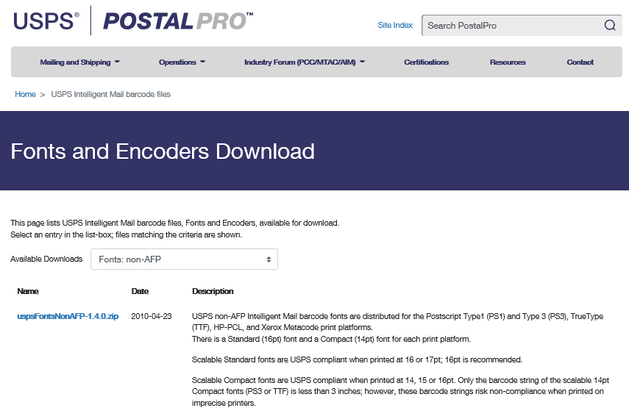
Mail Entry & Payment Technology
USPS IMb Font Download
At the Fonts and Encoders Download page, click on the “Available Downloads” dropdown and select Fonts: non-AFP
Notes:
Select Fonts: non-AFP

Slide 4
Mail Entry & Payment Technology
USPS IMb Font Download
Click on the uspsFontsNonAFP-1.4.0.zip link to download the zip file containing the fonts.
Notes:
Click on the uspsFontsNonAFP-1.4.0.zip link to download the zip file containing the fonts.

Slide 5
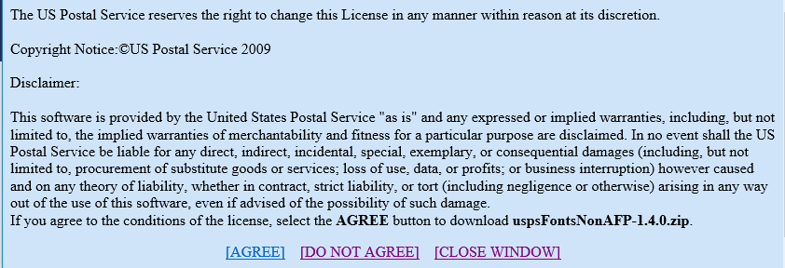
Mail Entry & Payment Technology
USPS IMb Font Download
Scroll to the bottom of the Intelligent Mail - Notice of License pop-up page and click on Agree.
Notes:
Click on Agree

Slide 6
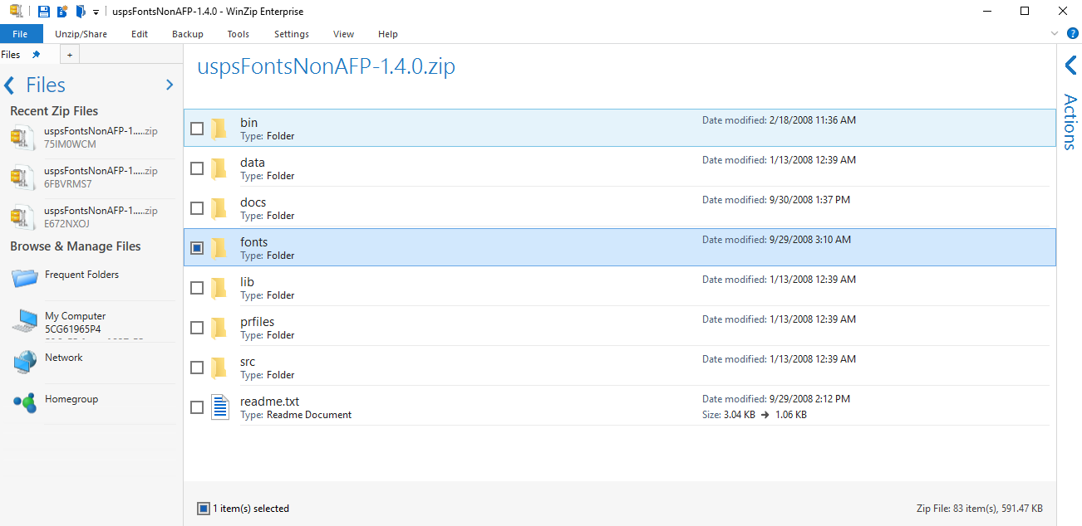
Mail Entry & Payment Technology
USPS IMb Font Download
After the zip file has downloaded to your computer, open it up and then double-click on the fonts folder to open it.
Notes:
Open the fonts folder in the zip file.

Slide 7
Mail Entry & Payment Technology
USPS IMb Font Download
Double click on the trueType folder to open it.
Notes:
Open the scalable folder. Open the trueType folder.

Slide 8
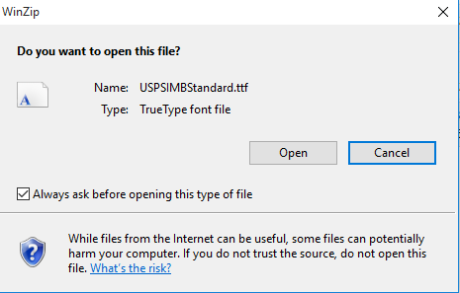
Mail Entry & Payment Technology
USPS IMb Font Download
Double click on the USPSIMBStandard.ttf to open it.
A pop-up box will appear. Click on the Open button to continue
Notes:
Open the USPSIMBStandard.ttf file. Refer to slide 12 for more information on using the compact IMb font.

Slide 9
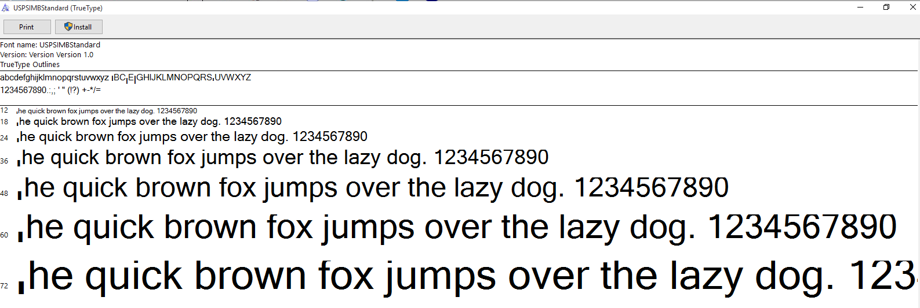
Mail Entry & Payment Technology
USPS IMb Font Download
Another pop-up will appear. Click on the Install button in the upper left corner to install the font to your system.
Note to USPS employees: You may not be able to download these fonts to some USPS computers.
Notes:
Click on the Install button.

Slide 10
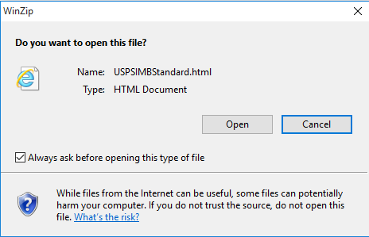
Mail Entry & Payment Technology
USPS IMb Font Download
After performing the installation, the font can be tested by double clicking on the USPSIMBStandard.html link in the trueType folder.
A pop-up box will appear. Click on the Open button to continue
Notes:
Test the font using the USPSIMBStandard.html link in the trueType folder.

Slide 11
Mail Entry & Payment Technology
USPS IMb Font Download
A browser window will open showing the text below. If the font is installed correctly, Line 2 should display the corresponding barcode for the alphanumeric characters in Line 1. Note: These fonts may not work on some USPS computers.

Slide 12
Mail Entry & Payment Technology
USPS IMb Font Download
You can use either font shown above, the Standard or the Compact version of the USPS IMB TrueType font.
Scalable Standard fonts are USPS compliant when printed at 16pt. (Recommended)
Scalable Compact fonts are USPS compliant when printed at 14, 15 or 16pt. Only the barcode string of the scalable 14pt Compact fonts (PS3 or TTF) is less than 3 inches; however, these barcode strings risk non-compliance when printed on imprecise printers.
Notes:
Users are recommended to use the Standard Fonts printed at 16 pt. when creating IMb.

